Slide 1

Xiao Zhu
Senior Research Scientist
Research Computing, Purdue University
January 11, 2017
Supercomputers,
Linux computing environment
ME 614

Slide 2
Overview
Who Are We?
IT Research Computing (RCAC) – a unit of ITaP (Information Technology at Purdue) – the central IT organization at Purdue.
Research Computing provides advanced computational resources and services to support Purdue faculty and staff researchers.

Slide 3
Overview
OUTline
Intro to Supercomputing
Linux Basics
Version Control (Git)

Slide 4
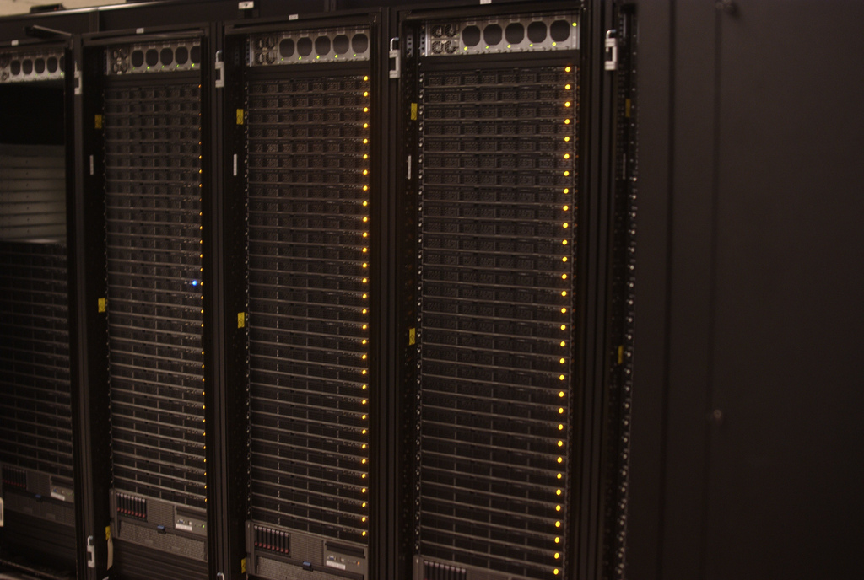
Section Title
Intro to
SUpercomputing

Slide 5
SUpercomputers
DEFINITION
Dictionary.com definition:
A very fast, powerful mainframe computer, used in advanced military and scientific applications.
For our sake:
A computer SYSTEM designed to operate at super high speeds which can perform complex calculations that would require a long period of time on a normal computer. Supercomputers mostly are multiple computers that perform parallel processing.
High Performance Computing, Supercomputing,
Parallel Computing

Slide 6
SUpercomputers
USE of Supercompters
Supercomputers are mainly used to simulate
Fluid Dynamics and Turbulence (Engineering/Physics)
Virtual CAD/CAM Design (Engineering)
DNA/Protein Structures (Biology/Bioinformatics)
Molecular Dynamics (Chemistry)
Fourier Transform and Algebraic Systems (Mathematics)
Earthquake and Seismic activity (Geology)
Global warming patterns (Environmental Sciences)
Solar atmosphere and Supernova Dynamics (Astronomy)
NO COMPUTER SCIENCE?

Slide 7
SUpercomputers
Performance Measurement
FLOPS: Floating point Operations Per Second
Usually prefixed by an SI unit of magnitude
Megaflops, Gigaflops, Teraflops, Petaflops
Useful in fields of scientific calculations that make heavy use of floating-point calculations
LINPACK: A benchmark software library written in FORTRAN to compute a n x n system of Linear Algebra.
The result is reported in FLOPS

Slide 8
SUpercomputers
World most powerful
SUpercomputers
Top Supercomputers as Nov 2016
Top Supercomputers of recent years

Slide 9
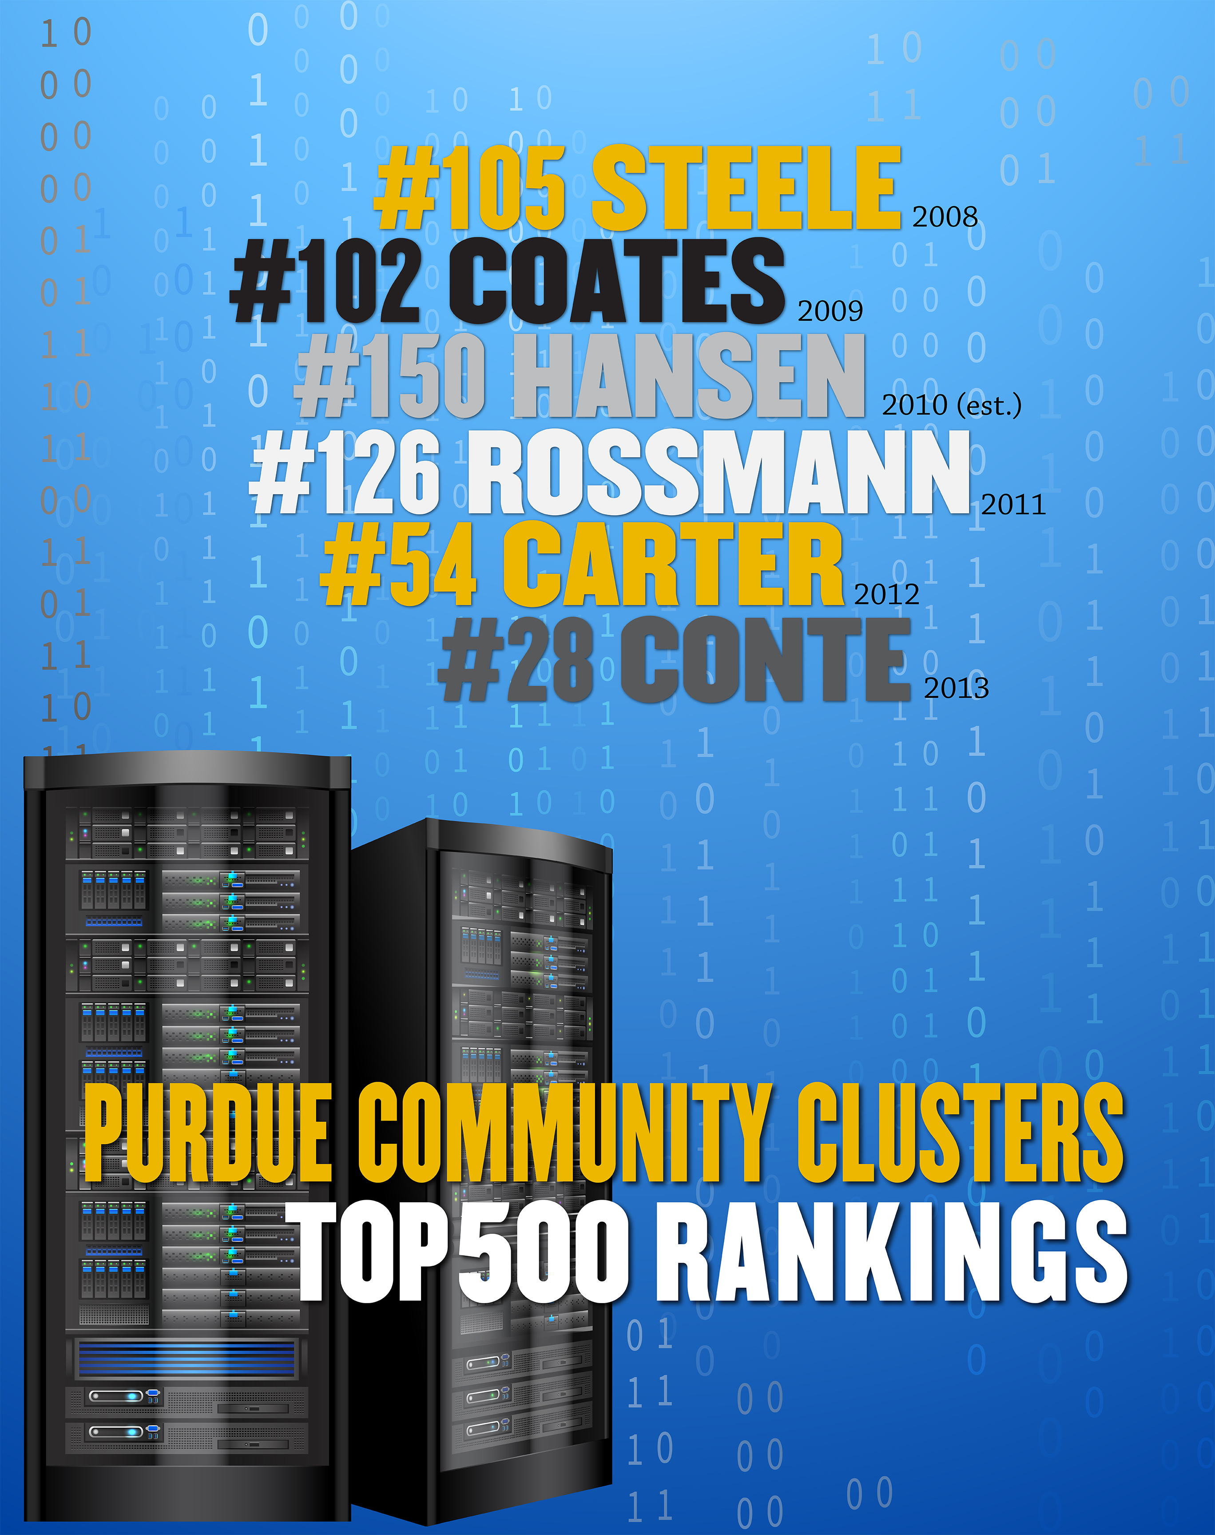
SUpercomputers
Purdue’s own
SUpercomputers
#166 RICE
2015

Slide 10
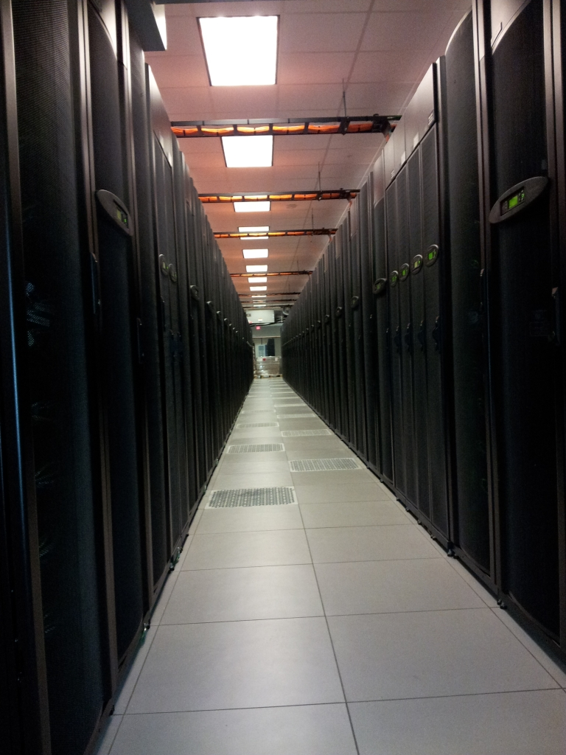
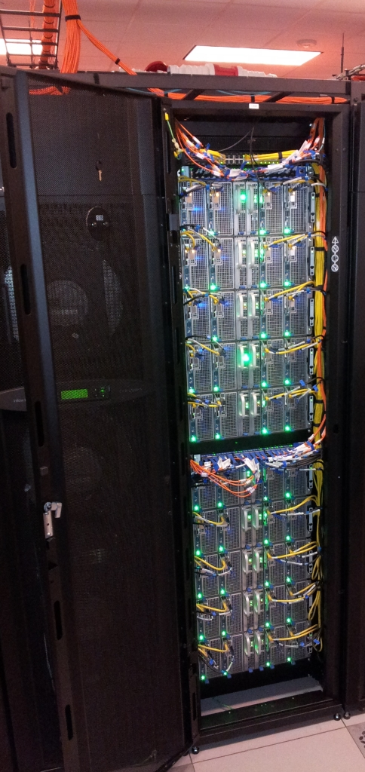
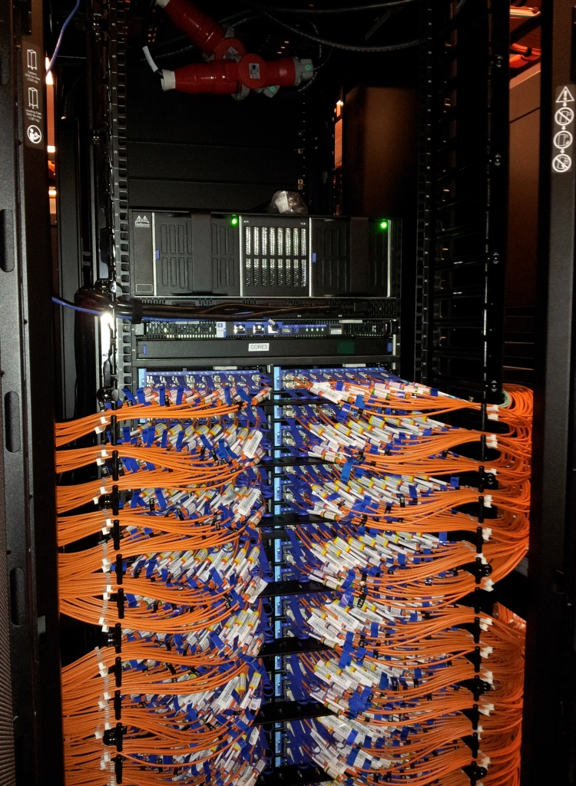
SUpercomputers
Clusters
Cluster: Hardware (compute nodes + interconnect + storage) + Software (OS + compilers + libraries + apps + queue manager) + Infrastructure (front-ends + power + cooling + data center + staff)

Slide 11
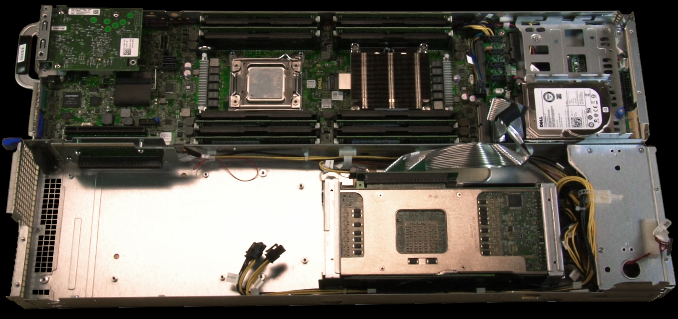
SUpercomputers
NODEs
Node: a computer
Network card
Memory
Memory
Processors
HDD
Intel Xeon Phi accelerator
Power supply

Slide 12
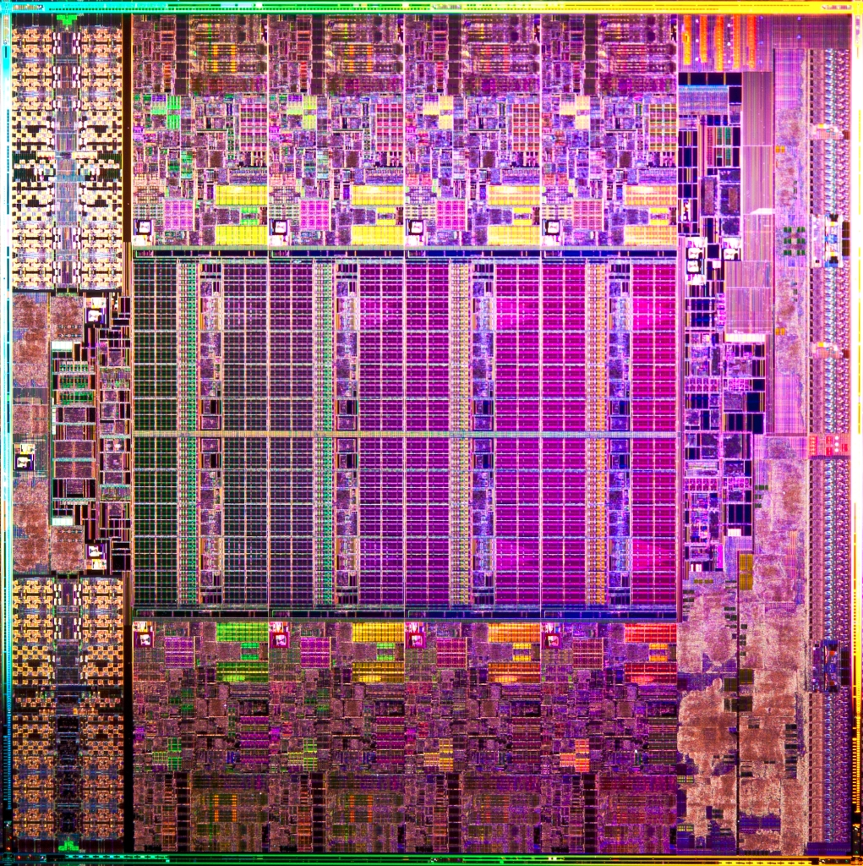
SUpercomputers
CPUS
Processor: a.k.a chip, a.k.a. physical CPU
Core
Controllers, I/O, etc.
Cache
Controllers, I/O, etc.
Core

Slide 13
SUpercomputers
cores
Processor Core: individual compute unit (“slot”) on the chip
Conventionally, we will be mostly concerned with cores (logical processors), not physical chips (“I ran on 6 CPUs” == “on 6 processors” == “on 6 cores”)
Processor
Processor
Rice/Halstead clusters:
2 physical processors, 10 cores ea.
Core
Core
Core
Core
Core
Core
Core
Core
Memory
Memory
Core
Core
QPI
Core
Core
Core
Core
Core
Core
Core
Core
Core
Core

Slide 14
Section Title
Intro to LINux
Computing environment

Slide 15
Overview
TOP 500 list dominated
By LINuX
Nearly Every Top 500 Supercomputer Runs On Linux

Slide 16
Overview
Why use Linux?
Performance: as we’ve seen, supercomputers generally run Linux; rich-multi user environment
Functionality: a number of community driven scientific applications and libraries are developed under Linux (molecular dynamics, linear algebra, fast-fourier transforms, etc).
Flexibility/portability: Linux lets you build your own applications and there is a wide array of support tools (compilers, scientific libraries, debuggers, network monitoring, etc.)
Security: users do not have root privilege/administrator access

Slide 17
Overview
What is linux?
Linux is a clone of the Unix operating system written from scratch by Linus Torvalds with assistance from developers around the globe (technically speaking, Linux is not Unix)
Torvalds uploaded the first version - 0.01 in September 1991
Only about 2% of the current Linux kernel is written by Torvalds himself but he remains the ultimate authority on what new code is incorporated into the Linux kernel.
Developed under the GNU General Public License, the source code for Linux is freely available
A large number of Linux-based distributions exist (for free or purchase)

Slide 18
Basics
How does Linux work?
Linux has a kernel and one or more shells;
The kernel sits on top of the hardware and is the core of the OS; it receives tasks from the shell and performs them;
The shell is the command interface through which the user interacts with the OS

Slide 19
Basics
SHELL and COMMAND
display
prompt
read
command
the shell
execute
command
The Shell
The user environment that enables interaction with the kernel, or lower-system OS.
User can use different shells on the same machine. (e.g., bash)
The Command Line
Interaction with Linux is based on entering commands to a text terminal
Often there are no ‘warnings’ with commands, no ‘undo’
process
command

Slide 20
Basics
Common shells
sh – the original Unix shell, still located in /bin/sh
bash – a Linux shell written for the gnu project and is installed on most Linux systems
csh – C shell, modeled after the C programming language used by linux systems
tcsh – C shell with modern improvements such as file name completion
echo $SHELL or echo $0 – displays what shell your account is using

Slide 21
BASICS
How to get help
Read the manual.
man command
man [section] command
man –k keyword (search all manuals based on keyword)
Most commands have a built-in manual, even the man command!
Commands without manuals have help too, with –h, --help, or /? option.

Slide 22
Basics
Account &
System access
To access a Linux system you need to have an account
Linux account includes:
Username and password
Userid and groupid
Home directory
A place to keep all your snazzy files
May be quota’d, meaning that the system imposes a limit on how much data you can have
A default shell preference
ssh username@hostname
ssh zhu472@rice.rcac.purdue.edu

Slide 23
Basics
FILE and process
Everything in Linux is either a file or a process;
A process is an executing program identified by a unique PID (process identifier). Processes may be short in duration or run indefinitely;
A file is a collection of data. Files are created by users using text editors, running compilers, etc;
The Linux kernel is responsible for organizing processes and interacting with files: it allocates time and memory to each processes and handles the file system and communications in response to system calls.

Slide 24

FILE
FILE
A file is a basic unit of storage (usually storage on a disk);
A “filesystem” is a collection of files stored on a single physical device.
often called “drives” in Windows
Examples of files:
a document (report, essay etc.)
the text of a program written in some high-level programming language
instructions comprehensible directly to the machine and incomprehensible to a casual user, for example, a collection of binary digits (an executable or binary file);
a directory, containing information about its contents, which may be a mixture of other directories (subdirectories) and ordinary files.
Notes:
We often think of a directory as a container that holds other files (or directories), Mac and Windows users can relate a directory to the same idea as a folder

Slide 25
FILE
FILE NAME
Every file must have a name
File names can contain any characters (although some make it difficult to access the file)
Linux file names can be long!
How long depends on your specific flavor of Linux?
Each file in the same directory must have a unique name
Files that are in different directories can have the same name
Note: Linux is case-sensitive
So, “Go-Boiler” is different than “go-Boiler”
Mac caveat: macos is NOT case sensitive

Slide 26
FILE
Good practice of
FILE NAME
In naming files, characters with special meanings such as / * & % , should be avoided. Also, avoid using spaces within names. The safest way to name a file is to use only alphanumeric characters, that is, letters and numbers, together with _ (underscore) and . (dot).
File names conventionally start with a lower-case letter, and may end with a dot followed by a group of letters indicating the contents of the file.
For example, all files consisting of PYTHON code may be named with the ending .py, for example, prog1.py .
Good filenames | Bad filenames
project.txt | project
my_big_program.c | my big program.c
fred_dave.doc | fred & dave.doc

Slide 27
FILE
An empty file or directory
Create an empty file
touch command will create an empty file
Syntax: touch filename
Example:
touch foo
Want more info? Read the man page!
Make a new directory
Syntax: mkdir directoryname

Slide 28
FILE
Directory Structure
An upside-down tree
All the files are grouped together in the directory structure. The top of the hierarchy is traditionally called root (written as a slash / )
/
bin
etc
home
tmp
usr
zhu472
scully
bin
etc
work
programs
docs
ls
who
data
report.doc
/home/zhu472/work/report.doc

Slide 29
FILE
FILE PATH
In Linux all files and directories have a “path”
The “path” of directories you must follow
Directories in the “path” to a file are separated by a “/”
Commands expect you to give them a path to a file.
More examples:
/home/zhu472/work/data
/bin
/home/scully/docs
/usr/bin/ls

Slide 30
FILE
Absolute vs relative path
Absolute paths
The path to a file starting at the root of the system
Begins with “/” to denote the path starts at the root
Guaranteed to get you there
Relative paths
The path to a file starting at the current location
Indicate current directory with “.”, parent directory as “..”
Can break if you start in the wrong place!

Slide 31
FILE
Absolute vs relative path
Assume current location is: /home/zhu472/work
Relative path Absolute path
report.doc /home/zhu472/work/report.doc
./report.doc /home/zhu472/work/report.doc
../scully/docs /home/scully/docs
../../usr/bin/ls /usr/bin/ls
Notes:
./ current directory
../ parent directory

Slide 32
FILE
WORKING directory
What is a working directory?
The directory your shell is currently associated with. At anytime in the system your login is associated with a directory
pwd – view the path of your working directory
ls – list content in your working directory
This command has many options, look at the man page for more info
ls -a (list all files and directories)
man ls
Note: use q to quit out of a manual

Slide 33
commands
CHANge directory
cd (change directory) command: is used change your working directory to another.
Syntax: cd directorypath
Changes your present location to the parent directory
cd ..
The directory which is up one level in the directory tree can be referred to as “..” dot dot

Slide 34
Commands
HOMe directory
Each user has a home directory. It is also called a login directory, the directory that a user is first in after logging into the system, which can be found with:
cd
cd ~zhu472
cd $HOME
The tilde character ~ will tell the shell to auto-complete the path statement for the cd command
$HOME refers to an environment variable which contains the path for home.

Slide 35
commands
List files
ls command: list files in current directory
Syntax: ls [option] [filepath]
-l long listing, includes file date and size
-a displays all files.
-h show file sizes in human readable terms
-t show the newest files first
Example:
ls -lht
ls -la /home/zhu472/work

Slide 36
commands
Copy a file or directory
cp (copy) command: is used to copy a file. When using this command you have to provide both source file and destination file.
Syntax: cp SOURCE DESTINATION
When copying directories make sure to use the option -R , -r , or --recursive to copy directories recursively, what this means is that every file and subdirectories inside that directory will be copied.
Syntax: cp –R SOURCE DESTINATION

Slide 37
commands
move a file or directory
mv (move) command: is used to move a file or a directory. Again, like the cp command you need to provide both source file and destination file.
Syntax: mv SOURCE DESTINATION
mv can also be used to rename files and directories
Syntax: mv OLDNAME NEWNAME

Slide 38
commands
Edit and read files
emacs vs. vi/vim
Among the largest ‘nerd battle’ in history known as the “Editor War”.
emacs relies heavily on key-chords (multiple key strokes), while vim is mode based. (editor mode vs. command mode)
vim users tend to enter and exit the editor repeatedly, and use the Linux shell for complex tasks, whereas emacs users usually remain within the editor and use emacs itself for complex tasks
vi/vim command cheat sheet
http://www.viemu.com/vi-vim-cheat-sheet.gif
http://www.cse.scu.edu/~yfang/coen11/vi-CheatSheet.pdf
emacs command cheat sheet
http://www.ic.unicamp.br/~helio/disciplinas/MC102/Emacs_Reference_Card.pdf

Slide 39
commands
Edit and read files
cat
Simplest form of displaying contents. It catalogs the entire contents of the file on the screen. In case of large files, entire file will scroll on the screen without pausing
less
If you only need to read a file (not edit it), programs like less give you “read only” access and a simplified interface
Displays file contents on the screen with line scrolling (to scroll you can use ‘arrow’ keys, ‘PgUp/PgDn’ keys, ‘space bar’ or ‘Enter’ key). When you are done press ‘q’ to exit.

Slide 40
commands
Edit and read files
head FILENAME
Displays only the starting lines of a file. The default is first 10 lines. But, any number of lines can be displayed using –n option (followed by required number of lines).
tail FILENAME
Similar to head, but displays the last 10 lines. Again –n option can be used to change this.

Slide 41
commands
Remove files
rmdir (remove directory) command: is used to delete directories from the system.
Syntax: rmdir DIRECTORY
The directory should be empty before you use the rmdir command.
rm command is used to delete file(s)
Syntax: rm -rf FILE
Some useful options include:
-i interactive, ask for confirmation
-r recursively delete files
-f delete forcefully
rm –rf * - most dangerous command you can run!

Slide 42
commands
Search pattern in files
grep is one of the most commonly used commands in UNIX.
Syntax: grep [OPTIONS] PATTERN [FILENAME]
grep searches the named input FILEs (or standard input if no files are named, or the file name – is given) for lines containing a match to the given PATTERN. By default, grep prints the matching lines.
Example: file example.txt contains:
Database: 1kp_blast_db.renamed.pep.fa
Posted date: May 6, 2011 3:04 PM
Number of letters in database: 7,896,286
Number of sequences in database: 21,309
We would like to find all lines containing “May 6”
$ grep "May 6" example.txt
Posted date: May 6, 2011 3:04 PM

Slide 43
commands
INPUT, OUTPUT
Programs and commands can contain an input and output. These are called ‘streams’. Linux programming is oftentimes stream based.
Programs also have an error output. We will see later how to catch the error output
STDIN – ‘standard input,’ or input from the keyboard
STDOUT – ‘standard output,’ or output to the screen
STDERR – ‘standard error,’ error output which is sent to the screen

Slide 44
commands
File redirection
Oftentimes we want to save output (stdout) from a program to a file. This can be done with the ‘redirection’ operator
myprogram > myfile
Similarly, we can append the output to a file instead of rewriting it with a double >>
myprogram >> myfile
Input can also be given to a command from a file instead of typing it to the screen, which would be impractical.
myprogram < programinput
Example: cat list1 list2 > biglist

Slide 45
commands
PIPEs
Using a pipe operator (|) commands can be linked together. The pipe will link the standard output from one command to the standard input of another.
Helpful for using multiple commands together to perform a task.
Examples: history | grep "ls”
ls -1 |grep Aug| wc –l

Slide 46
commands
WILDCARD
The * wildcard
The character * is called a wildcard, and will match against none or more character(s) in a file or directory name.
Example,
$ ls list*
This will list all files in the current directory starting with list....
$ ls *list
This will list all files in the current directory ending with ....list
The ? wildcard
The character ? will match exactly one character. So ?ouse will match files like house and mouse, but not grouse.

Slide 47
commands
Helpful Hints on Space
How much space am I taking up?
Almost all commands that deal with file space will display information in Kilobytes, or Bytes. Nobody finds this useful.
Many commands will support a -h option for “Human Readable” formatting
df - display space information for the entire system
Example: df -h .
du - command to find out how much space a folder or directory uses.
Example: du –sh *
ls –lh - displays the working directory files with a long listing format, using “human readable” notation for space

Slide 48
commands
Find a file
find command searches through the directories for files and directories with a given name, date, size, or any other attribute you care to specify. It is a simple command but with many options - you can read the manual by typing man find.
Examples:
To search for all files with the extention .txt, starting at the current directory (.) and working through all sub-directories, then printing the name of the file to the screen, type
$ find . -name "*.txt" -print
To find files over 1Gb in size, and display the result as a long listing, type
$ find . -size +1G -ls

Slide 49
commands
FILE transfer
Both scp and rsync are simple file transfer tools.
scp usage:
Syntax: scp [options] SOURCE DESTINATION
Example:
$ scp report.doc zhu472@scholar.rcac.purdue.edu:
This will copy the file report.doc to Scholar in my home folder (/home/zhu472)
You could also provide the full path
$ scp report.doc zhu472@scholar.rcac.purdue.edu:/home/zhu472

Slide 50
conclusion
How to get help
Read the manual.
man command
man [section] command
man –k keyword (search all manuals based on keyword)
Most commands have a built-in manual, even the man command!
Commands without manuals have help too, with –h, --help, or /? option.

Slide 51
conclusion
Useful references
There is a lot of information presented here, don’t become overwhelmed.
Linux is a full featured OS with plenty of useful tools right out of the box.
Useful references:
https://www.rcac.purdue.edu/tutorials/unix101/unix101.pdf
https://www.rcac.purdue.edu/compute/rcac_cluster_reference.pdf
http://www.ee.surrey.ac.uk/Teaching/Unix/

Slide 52
conclusion
Summary of
useful commands
command | What it does
man | display manual pages
ls | list directory contents
cd | change directory
pwd | print working directory
cp | coy files
rm | remove files
mkdir | make directories
rmdir | remove directories
head | display first lines of a file
tail | display the last part of a file
touch | change file access and modification time
cat | concatenate and print file
less | a filter for paging through text one screenful at a time

Slide 53
conclusion
Summary of
useful commands
command | What it does
find | walk a file hierarchy
grep | print liens matching a pattern
chmod | change file mode or permissions
date | print out current date/time
diff | report differences between two files
wc | show number of lines, words in a file
sort | sort a file line by line
uniq | remove duplicate lines from a sorted file
file | determine file type
which | show full path to a command
scp | secure copy to transfer file remotely
tar | archiving utility
gzip/gunzip | compress/uncompress a file

Slide 54
Version control
What is version control?
A system that records changes to a file or set of files over time so that you can recall specific version later.
You are using version control without noticing!
Copy files into another directory in your local/remote workstations.

Slide 55
Version control
Why version control?
Traceability
Review changes made over time
Know what code (which version) was under use
Know when and how things were changed by yourself or other team members
Reproducibility
Revert files back to a previous state
Revert the entire project back to a previous state
Easy to share
Collaboration
Allow contributions without risking code breakage
Organization
Enforce a method of organization

Slide 56
Version control
GIT
Clients fully mirror the repository!
Every version is a snapshot of all files.
Most operations only need local files and resource to operate.
Only a few operations interact with the remote repository (e.g., clone, pull, push)

Slide 57
Version control
Basic GIT workflow
Remote Repository
Modify files in your working directory;
Stage files, adding snapshots to the staging area;
Commit files, take the files in the staging area and store them permanently to the git directory, which are ready to be pushed to the remote repository.

Slide 58
Version control
GIT init
git init: create an empty repository or reinitialize an existing one
$ mkdir test_class
$ cd test_class/
$ git init
Initialized empty Git repository in /Users/zhu472/Documents/research/training/me614/test_class/.git/
git is your local repository. Do not modify/delete it!

Slide 59
Version control
GIT add
git add: add file contents to the index
$ echo “Hello from Xiao” >> README
$ git add README

Slide 60
Version control
GIT status
git status: show the working tree status
$ git status
On branch master
Initial commit
Changes to be committed:
(use "git rm --cached <file>..." to unstage)
new file: readme

Slide 61
Version control
GIT commit
git commit: record changes to the repository
$ git commit –m “Adding README”
[master (root-commit) b511d7c] Adding README
1 file changed, 1 insertion(+)
create mode 100644 readme

Slide 62
Version control
GIT log
git log: show the commit logs
$ git log
Commit b511d7ccf3b96db651b1b827b1933faf67ad1ffa
Author: Xiao Zhu <zhu472@purdue.edu>
Date: Sat Jan 7 23:57:57 2017 -0500
Adding README
Make your comments (history) meaningful!

Slide 63
Version control
More modification
$ echo “Adding line 2” >> README
$ git add README
$ git commit –m “Adding line 2”
$ echo “Adding line 3” >> README
$ git add README
$ git commit –m “Adding line 3”
$ echo “Clear file” >> README
$ git commit –am “Clear file”

Slide 64
Version control
GIT LOG
$ git log
$ git log README #can view log for an individual file
commit 7aae7c78f898e967f65966f088ebe2327ccff0d7
Author: Xiao Zhu <zhu472@purdue.edu>
Date: Sun Jan 8 00:11:27 2017 -0500
Clear file
commit 94872844a1c53efd3cdeacb2e17e9217b805df09
Author: Xiao Zhu <zhu472@purdue.edu>
Date: Sun Jan 8 00:11:11 2017 -0500
Adding line 3
commit cd75c59031f62a138194397c5fe93d3b19c35389
Author: Xiao Zhu <zhu472@purdue.edu>
Date: Sun Jan 8 00:10:58 2017 -0500
Adding line 2
commit b511d7ccf3b96db651b1b827b1933faf67ad1ffa
Author: Xiao Zhu <zhu472@purdue.edu>
Date: Sat Jan 7 23:57:57 2017 -0500
Adding README

Slide 65
Version control
REMOTE Commands
$ git remote add origin \
ssh://git@github.rcac.purdue.edu/zhu472/test_class.git
$ git push –u origin master
Counting objects: 12, done.
Delta compression using up to 8 threads.
Compressing objects: 100% (5/5), done.
Writing objects: 100% (12/12), 970 bytes | 0 bytes/s, done.
Total 12 (delta 0), reused 0 (delta 0)
To ssh://git@github.rcac.purdue.edu/zhu472/test_class.git
* [new branch] master -> master
Branch master set up to track remote branch master from origin.
Remote repository
After creating empty repository:
– Import at bitbucket or push files from local system
• For convenience name local directory of repository and remote repository the same name

Slide 66
Version control
REview
Remote Repository
git clone
git pull
git push
git commit
git add
git status

Slide 67
Version control
References
Git Cheat Sheet from Github
https://training.github.com/kit/downloads/github-git-cheat-sheet.pdf
Pro Git written by ScoJ Chacon
http://git-scm.com/book
Atlassian Git Tutorial
https://www.atlassian.com/git
Git reference:
http://gitref.org/

Slide 68
SUpercomputers
SCHolar
A HPC resource dedicated to course teaching
Computing resource on Rice cluster
User Guide: https://www.rcac.purdue.edu/compute/scholar/
How to access the system
$ ssh zhu472@scholar.rcac.purdue.edu
zhu472@scholar.rcac.purdue.edu's password:

Slide 69
SUpercomputers
HOMEwork 0.1
Please log in scholar.rcac.purdue.edu;
Username: <Your Purdue Career Account>
Password: < Your Purdue Career Account Password>
Make sure you have the access to Scholar, where your will finish HPC homework.
Example:
$ ssh usrename@scholar.rcac.purdue.edu
username@scholar.rcac.purdue.edu's password:

